Slide 1
ENGINE COMPONENTS
(Valve mechanism)
Department of mechanical engineering
Pulchowk Campus, IOE
Tribhuan Universtiy
2016

Slide 2
VALVES AND VALVE TRAINS
Task
  To allow fresh air-fuel mixture (air) to enter into the cylinder during intake stroke and exhaust gas to escape out of cylinder during exhaust stroke
Types
  Side valve engines (rarely used): the valves are located along the side of the cylinder and have their heads at the top.
  Overhead valve engines: the valves are inverted, and therefore close as the piston moves towards TDC. The valves are above the cylinder, in the cylinder head.

Slide 3
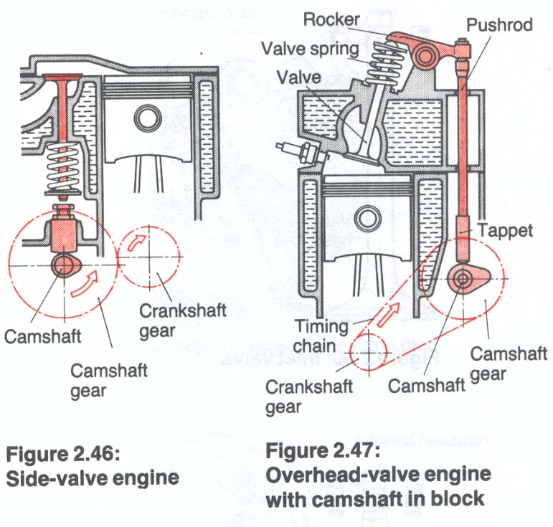
Valve location

Slide 4
VALVES AND VALVE TRAINS
Main components
  Side valve engine: camshaft gear, camshaft, cam, valve springs, valves
  Overhead valve engines (pushrod engine): camshaft gear , camshaft, cam, tappet, pushrod, rocker, valve springs, valves (on side mounted camshaft).
  Overhead camshaft engine (OHC):
    Single overhead camshaft
    Double overhead camshaft

Slide 5
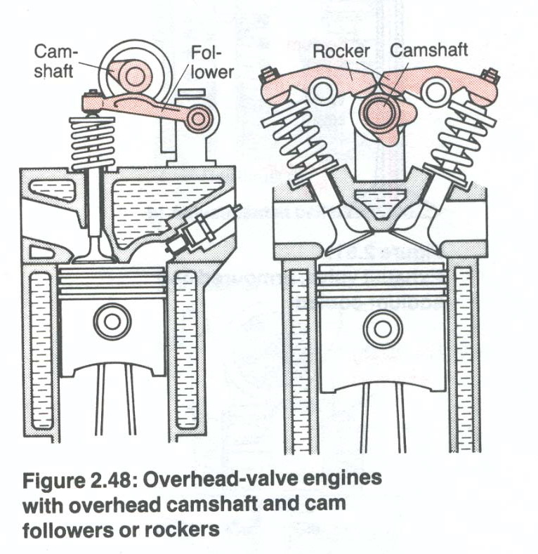
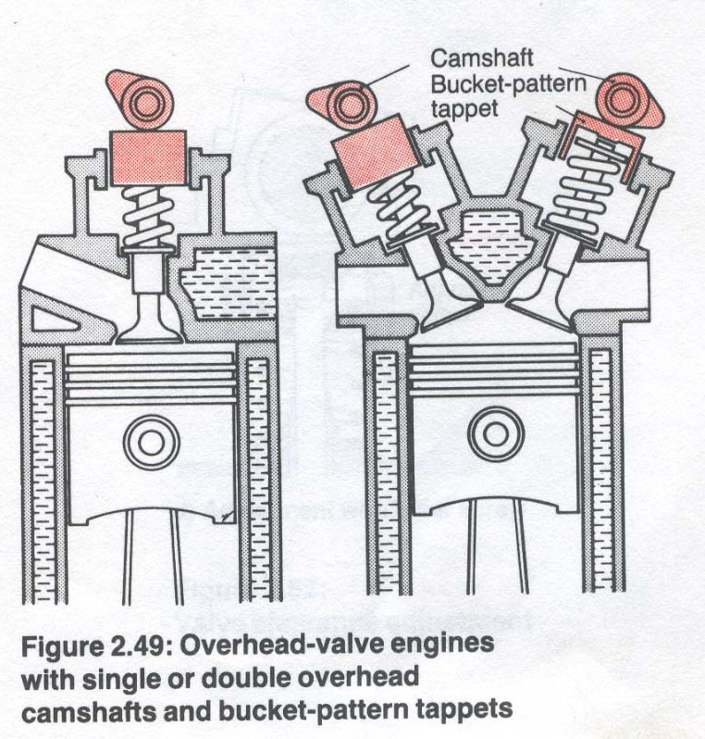
VALVE DESIGN AND LOCATIONS

Slide 6
VALVES
Each cylinder has two valves, an intake valve and exhaust valve.
High performance engines have four valves per cylinder – two intake valves and two exhaust valves.
The intake valves is larger than the exhaust valve.
The exhaust valve is thicker than the intake valve in size.
Valve cooling:
  Intake valve: by fresh air-fuel mixture
  Exhaust valve: by conduction to valve guide and valve seat (which are cooled by engine cooling system). Some heavy duty engines have exhaust valve with a fat hollow stem partly filled with metal sodium. Sodium melts at approx. 98°C.
Materials
  Inlet valve: chromium silicon steel
  Exhaust valve: corrosion and scale resistant chromium silicon steel

Slide 7
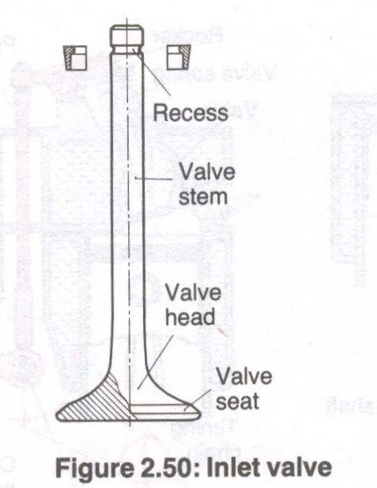
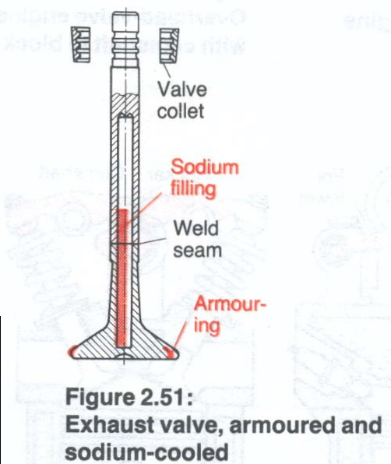
VALVES

Slide 8
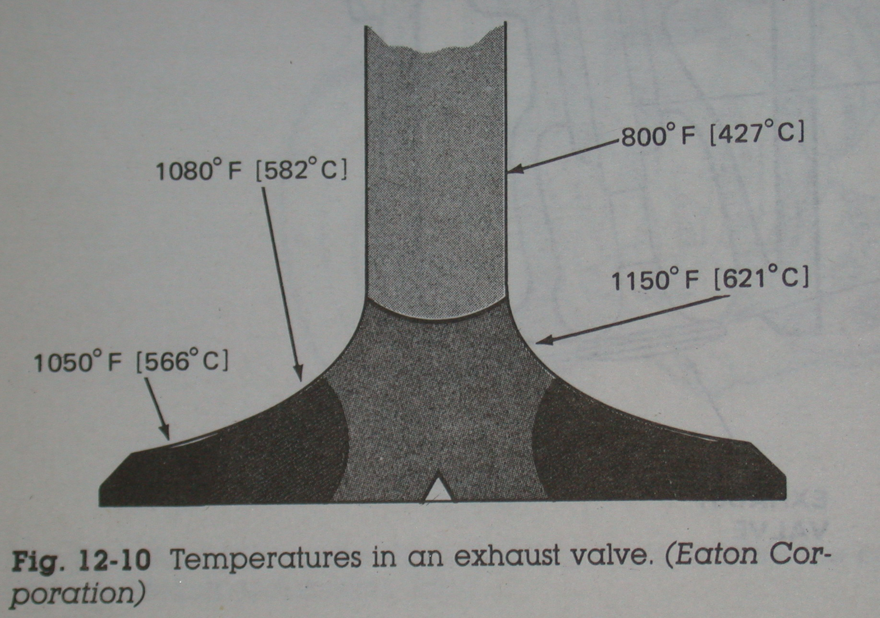

Slide 9
VALVE CLEARANCE
To ensure that the valves close reliably in all operating situations, a small amount of clearance has to be left between the valve gear components.
When the engine is cold, valve clearances are usually slightly larger than when it is warm. The exhaust valve is usually operated with slightly more clearance than the inlet valve.
Valve Clearance: 0.1 – 0.3mm

Slide 10
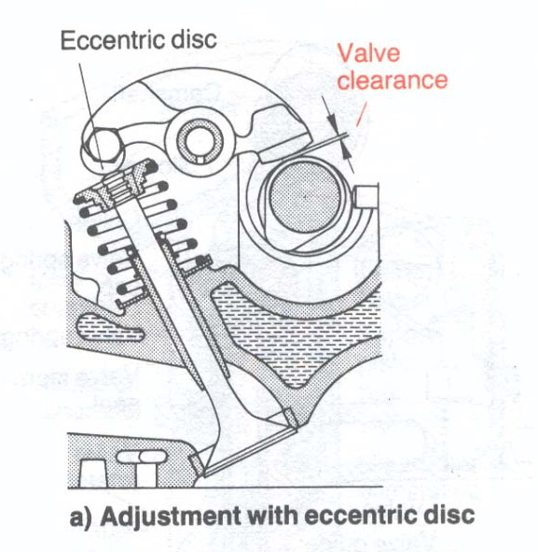
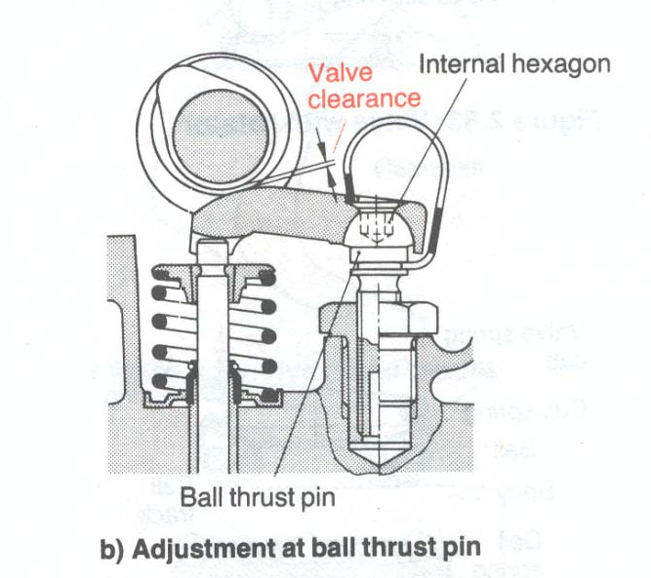
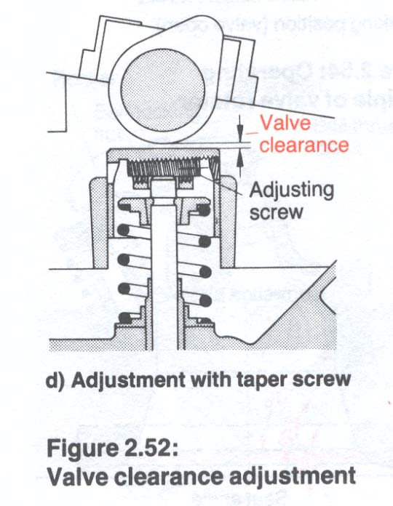
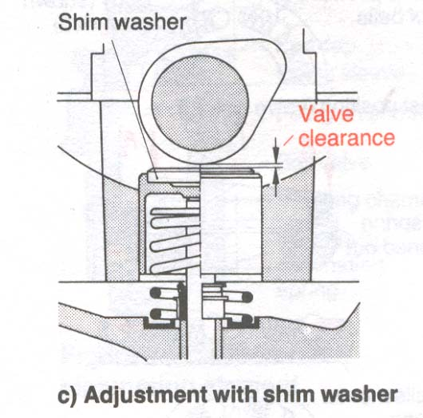
VALVE CLEARANCE ADJUSTMENT

Slide 11
INCORRECT VALVE CLEARANCE
If valve clearances are too small:
  The valve opens too soon and closes too late. The exhaust valve in particular cannot transfer enough heat in the shorter closed period from the head to the seat in the cylinder head, and tends to overheat.
  There is a risk of the exhaust or inlet valves not closing properly when the engine is warm (possibilities of backfire and burning of valve head and seat).
If valve clearances are too great:
  The valves opens too late and closes too early.
  The full open period and flow cross-section are not obtained, so that cylinder charge and power output suffer.
  The mechanical loads on the valve and the resulting noise are also greater.

Slide 12
VALVE ROTATION
If the exhaust valve rotates as it opens, there is less chance of valve stem deposits causing the valve to stick.
Valve rotation results in more even valve head temperature causing longer exhaust valve life.
Valve rotators: The rotation of the valve removes the deposits that form on the valve face and stem thus ensuring improved gas seal and heat transfer.
  Free type valve rotator
  Positive valve rotator

Slide 13
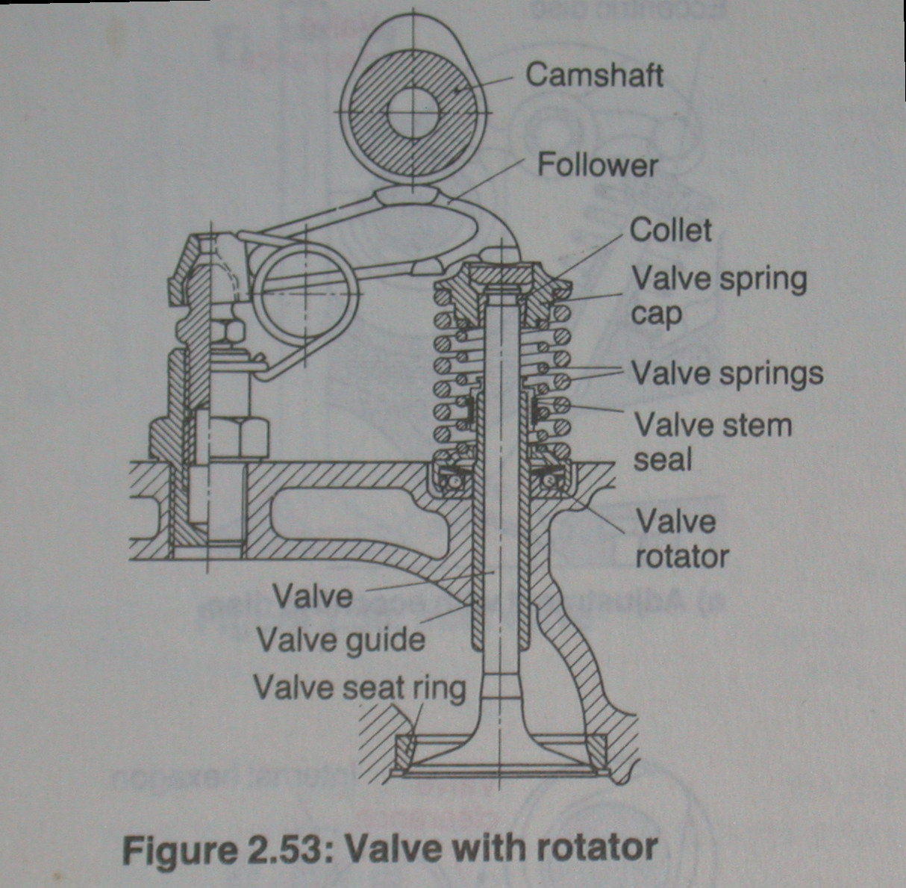
Valve Rotation

Slide 14
VALVE GUIDE
Valve guides keep the valves in alignment with the valve seat during engine operation.
The valve stem is manufactured to fit in the valve guide with very fine clearance.
The valve guides can be either removable or an integral part of the cylinder head.
The removable guides are a press fit in the cylinder head and require a special tool to install them.

Slide 15
VALVE SEATS
When the valve is said to be closed the valve seating face makes contact with the valve seat in the cylinder heat to seal off the cylinder preventing movement of air or gases into the ports.
The valve seat also is responsible for good heat transfer. When the valve closes, heat is transferred from the valve head through the valve seat to the cylinder heads cooling system.
Some engines have replaceable valve sea inserts that are a press fit into the cylinder head.
The valve seating face and the valve seat must be a gas tight seal and to achieve this they are machined accurately and seal effectively over a long period of time with relatively little attention.

Slide 16
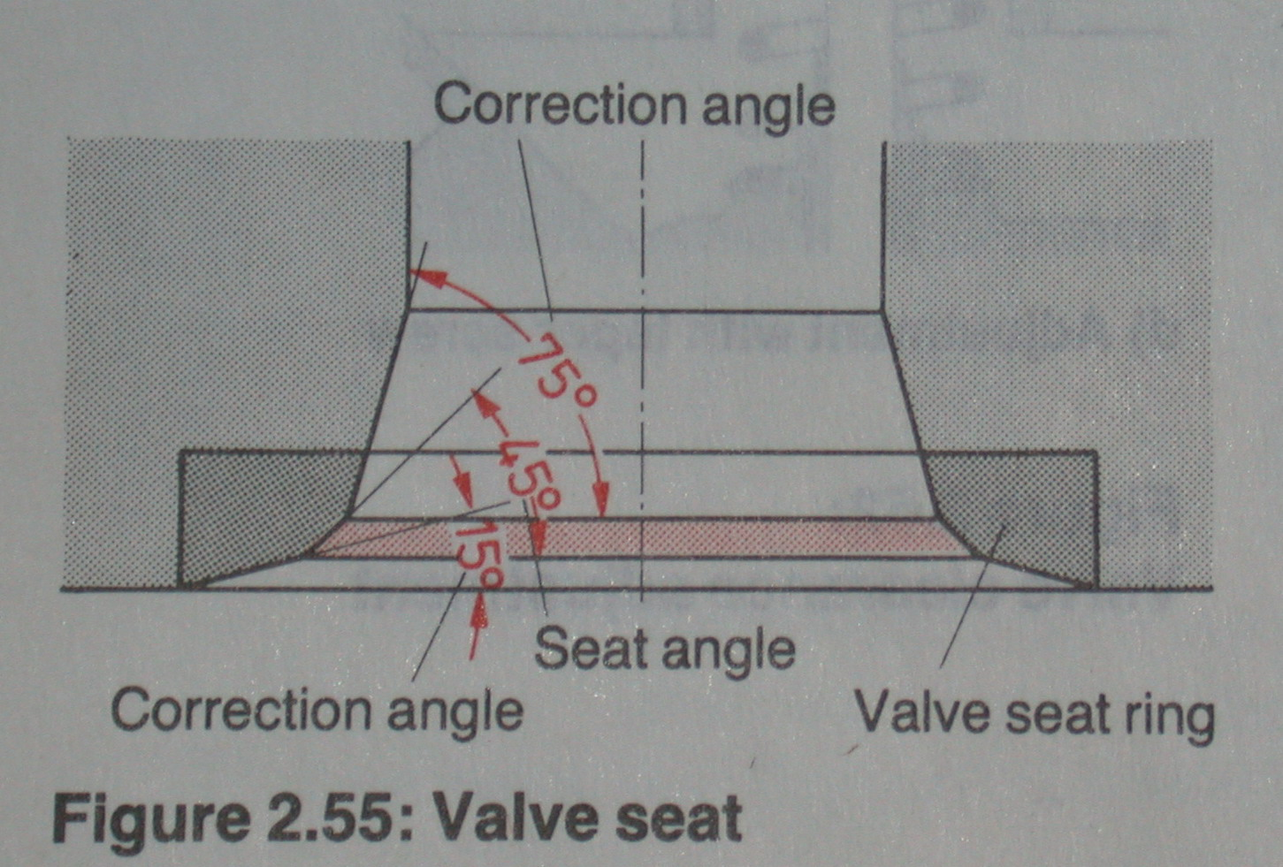

Slide 17
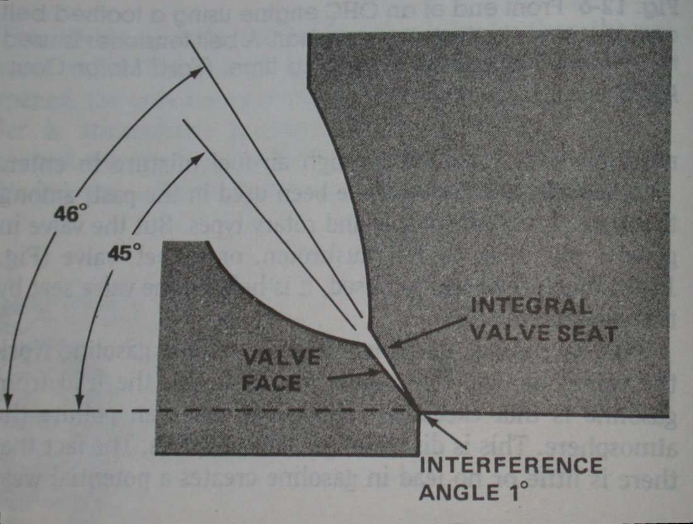
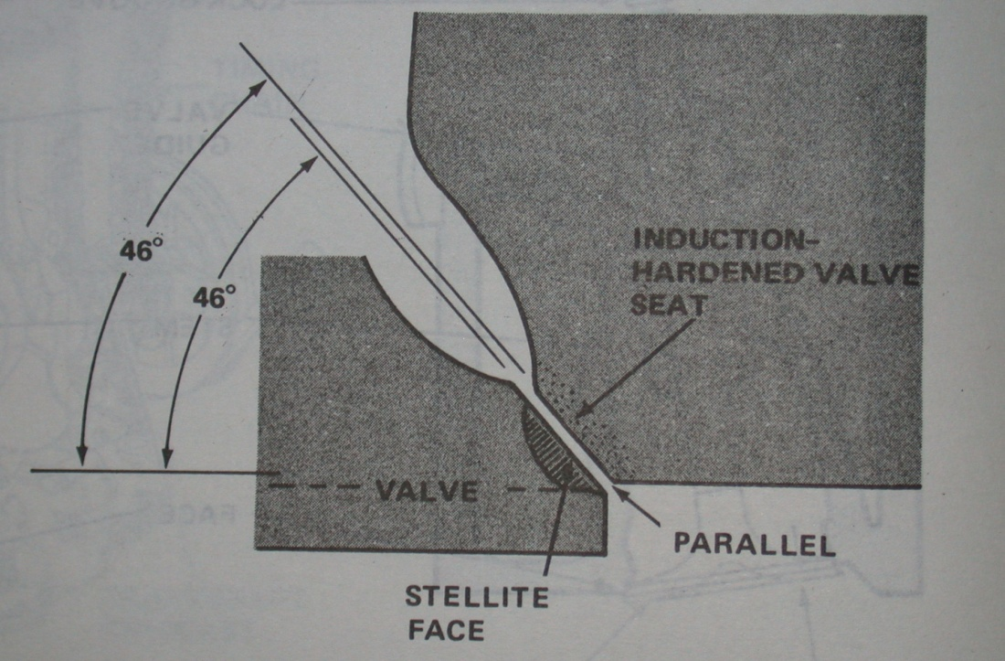
VALVE AND VALVE-SEAT ANGLES

Slide 18
VALVE SPRINGS AND RETAINING PARTS
The valve spring returns the valve to its seat and holds it there until the camshaft, via the valve operating mechanism, forces the valve off its seat.
To dampen spring vibrations that occur after the valve closes two methods are used.
  Variable rate valve springs
  Reverse wound secondary spring
Spring retainers: these hold the top end of the valve in place.
Collets: these lock the retainers in place to complete the valve spring assembly.

Slide 19
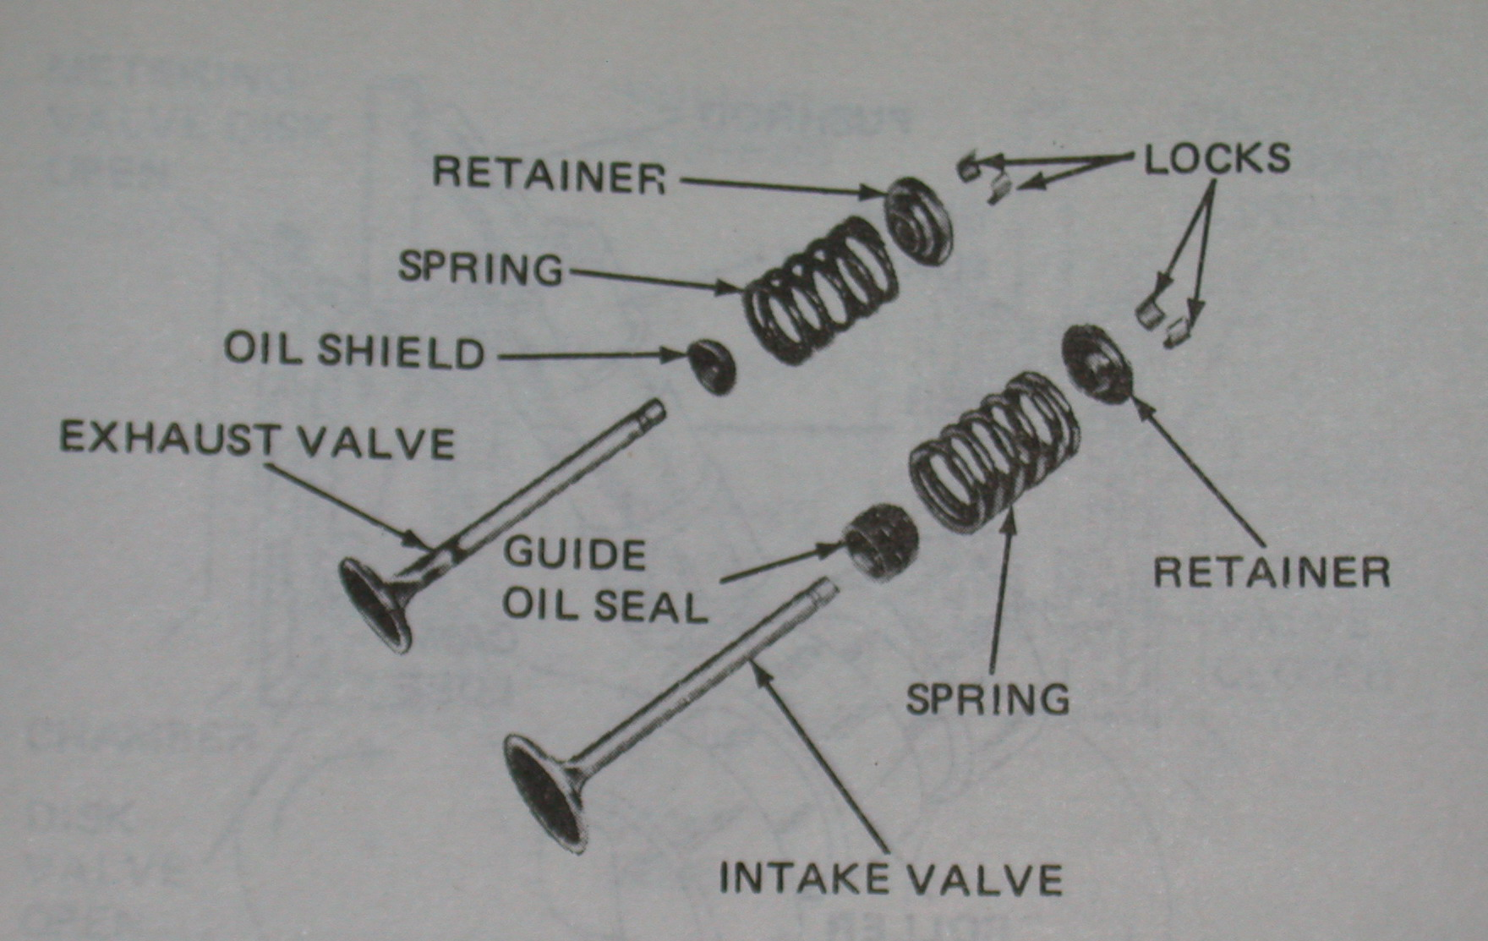
VALVES

Slide 20
ROCKERS
Rockers are double ended levers which transmit the lifting action of the cam to the valve stem.
They usually run in copper-tin alloy bushings on the rocker shaft, but can also be supported at their pivot point on a ball and socket joint on top of a post.
To adjust valve clearances, the rockers either have an adjusting screw with a locknut or eccentric, or are adjusted by means of a self-locking nut on the locating post.
Rockers are steel drop forgings or stampings, with hardened contact pads.

Slide 22
CAM LOBE
The design of the cam lobe contour has a major effect on engine performance and controls the following.
  The amount of valve opening
  How long the valve remains open
  When the valves open and close (valve timing)
  The speed at which the valves open and close
The cam follower bears directly on the cam and transmits its rotating movement to the push rod in and up and down form.

Slide 23
CAMSHAFT BEARINGS
The camshaft rotates in bearings in the cylinder block. The bearings are round in shape and similar in design to big-end and main bearings. These bearings are pressed into the block and machined out accurately.

Slide 24
CAMSHAFT DRIVE MECHANISM
To ensure correct valve timing camshafts are driven at one-half crankshaft sped on four stroke cycle engine. The reduction is achieved by one of these methods:
  Gear drive: The camshaft gear is double in size to crankshaft gear in diameter
  Chain drive (a chain and sprocket set): The small sprocket on the crankshaft drives the large camshaft sprocket a half crankshaft speed. A timing chain tensioner is used to maintain an even tension on the chain and to take up any wear that may occur during the chain’s normal service life.
  Belt drive: Timing belt and sprockets are now used on some engines. The belt is constructed or cords moulded into a neoprene/rubber compound. They have the advantage of not needing lubrication. A tensioner is included to maintain correct tension of the belt at all times.

Slide 25
VALVE TIMING
The camshaft is ground with a particular valve opening and closing sequence. This cannot be altered without changing the complete camshaft over to another design.
Timing of the valves is controlled by the shape of the lobe on the cam and the relationship between the gears or sprockets and chain on the camshaft and crankshaft.

Slide 26
VALVE TIMING
Changing the relationship between the driving and driven gears or sprockets changes the timing at which the valves open and close.
Incorrect valve timing may result in the following
  Poor cylinder filling
  Poor exhausting
  Mechanical damage caused by valves hitting the pistons

Slide 27
VALVE TIMING METHODS
In the gear drive system both gears are usually marked and should be lined up at the point where they mesh together when installing the camshaft.
Chain drive systems can be time in a similar manner, with the two marks lined up.
The timing belt or toothed belt system may have a mark on the belt that lines up with a camshaft sprocket mark and a crankshaft mark that must line up with a a mark on the housing.

Slide 28
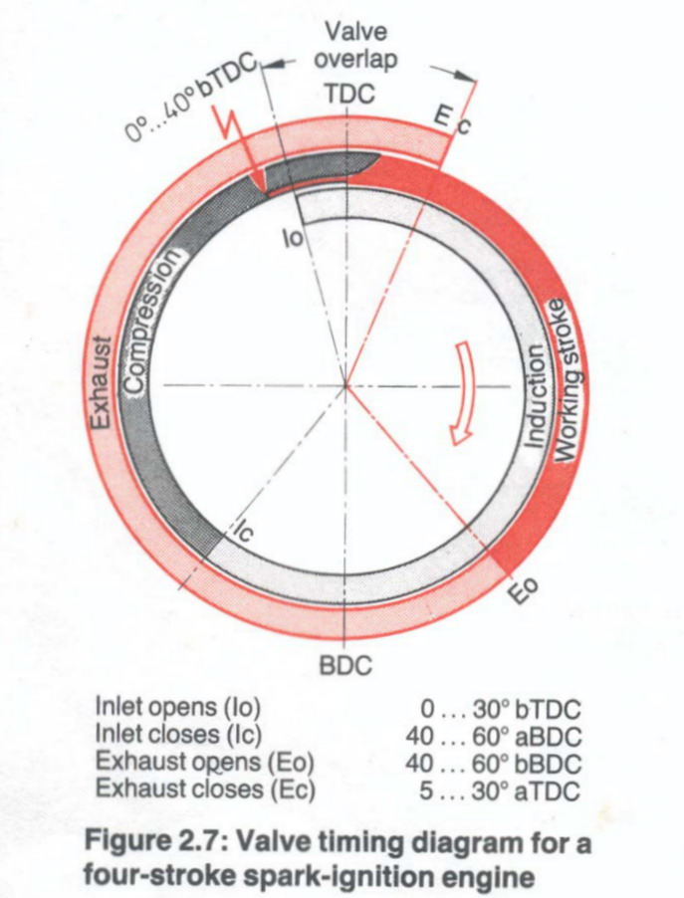
VALVE TIMING DIAGRAMS
The exhaust valve starts to open at 47 degrees before BDC on the power stroke. It stays open until 21 degrees after TDC on the intake stroke. This gives more time for the exhaust gases to leave the cylinder.
The intake valve starts to open at 12 degrees before TDC and remains open for 56 degrees past BDC after the intake stroke. This gives additional time for air-fuel mixture to flow into the cylinder.

Slide 29
CONCLUSIONS
Valves play important role in the performance of engine.
Proper adjustment of valve clearance is necessary for good performance of engine.
Similarly, the valve timing plays vital role in inletting the air-fuel mixture and exhausting the gases.

